Slide 1
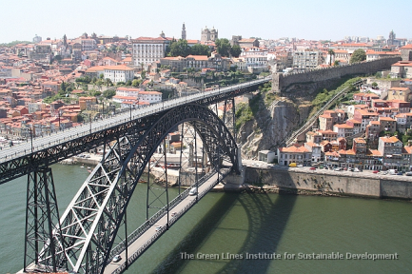
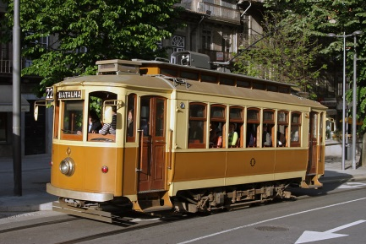
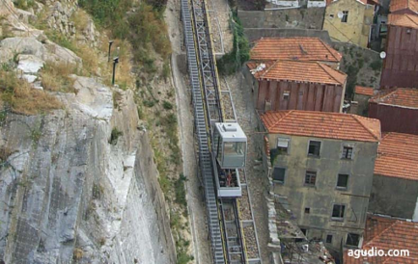
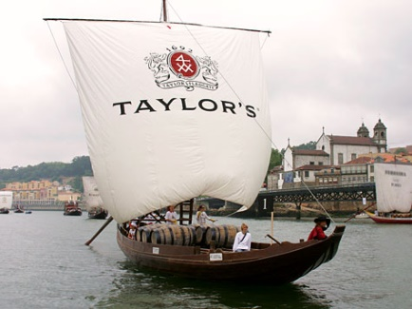


Going Dutch: How to Share a Dedicated Distributed Infrastructure for Computer Science Research
Henri Bal Vrije Universiteit Amsterdam
Notes:
Earlier keynotes on programming environments (Ibis)
Inv 2 days after das5 acceptance (19-21 feb)

Slide 2
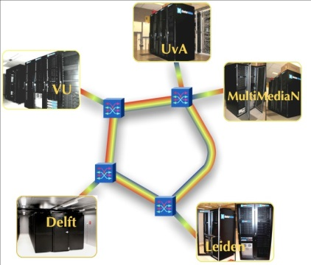

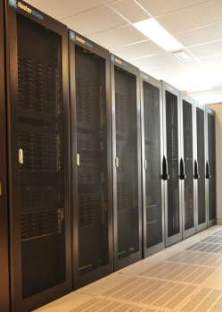
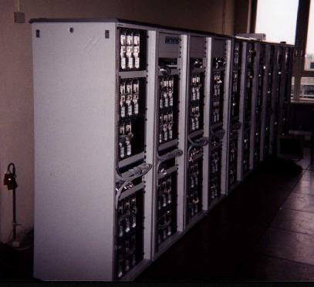
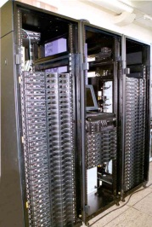
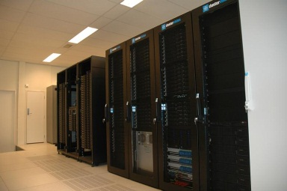
Agenda
Overview of DAS (1997-2014)
Unique aspects, the 5 DAS generations, organization
Earlier results and impact
Examples of current projects
DAS-1
DAS-2
DAS-3
DAS-4
Notes:
Projects you may or may not have seen, depending on your age

Slide 3
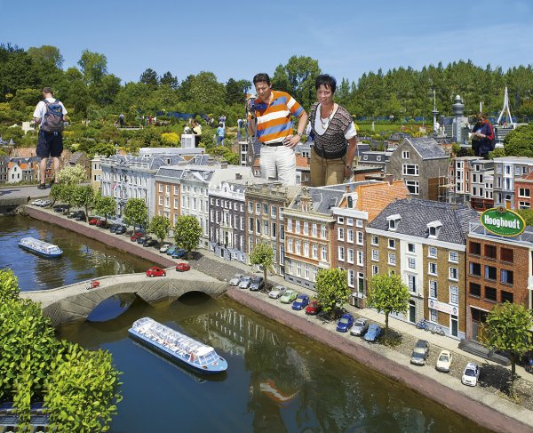
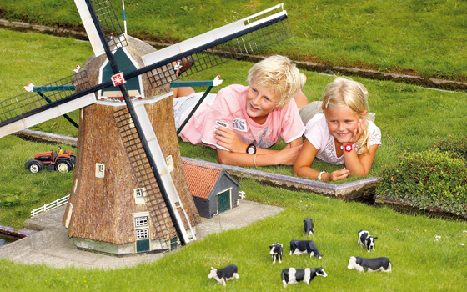
What is DAS?
Distributed common infrastructure for Dutch Computer Science
Distributed: multiple (4-6) clusters at different locations
Common: single formal owner (ASCI), single design team
Users have access to entire system
Dedicated to CS experiments (like Grid’5000)
Interactive (distributed) experiments, low resource utilization
Able to modify/break the hardware and systems software
Dutch: small scale
Notes:
{no phone calls, no arm twisting}
(one password file)
G5K allows access to raw hardware, we don’t’

Slide 4


About SIZE
Only ~200 nodes in total per DAS generation
Less than 1.5 M€ total funding per generation
Johan Cruyff:
"Ieder nadeel heb zijn voordeel"
Every disadvantage has its advantage
Notes:
Original context was soccer

Slide 5
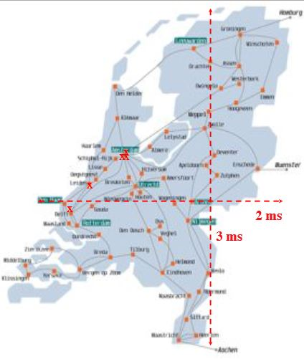
Small is beautiful
We have superior wide-area latencies
“The Netherlands is a 2×3 msec country” (Cees de Laat, Univ. of Amsterdam)
Able to build each DAS generation from scratch
Coherent distributed system with clear vision
Despite the small scale we achieved:
3 CCGrid SCALE awards, numerous TRECVID awards
>100 completed PhD theses
Notes:
{JOKE: TUD speed-of-light} NL is the place to be for efficient wide-area algorithms
Can simulate longer latencies
Unlike G5K: synchronous (DAS) vs asynchronous (G5K)
Mention g5k meeting
They: breakable, raw hw, stufy instrument
We enable cs research p&dc

Slide 6
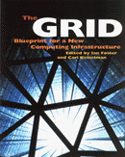


DAS generations: visions
DAS-1: Wide-area computing (1997)
Homogeneous hardware and software
DAS-2: Grid computing (2002)
Globus middleware
DAS-3: Optical Grids (2006)
Dedicated 10 Gb/s optical links between all sites
DAS-4: Clouds, diversity, green IT (2010)
Hardware virtualization, accelerators, energy measurements
DAS-5: Harnessing diversity, data-explosion (2015)
Wide variety of accelerators, larger memories and disks
Notes:
Das-1: metacomputing
Das-3 problem changes from what to do with slow WAN into How to use the abundant bandwidth
DAS-4: homogeneous core + different types of accelerators

Slide 7
ASCI (1995)
Research schools (Dutch product from 1990s), aims:
Stimulate top research & collaboration
Provide Ph.D. education (courses)
ASCI: Advanced School for Computing and Imaging
About 100 staff & 100 Ph.D. Students
16 PhD level courses
Annual conference
Notes:
ASCI is a real community; I & C marriage, I starts taking over habits, DC, gpus
Work together iso writing sla’s
{top 98%}

Slide 8





Organization
ASCI steering committee for overall design
Chaired by Andy Tanenbaum (DAS-1) and Henri Bal (DAS-2 – DAS-5)
Representatives from all sites: Dick Epema, Cees de Laat, Cees Snoek, Frank Seinstra, John Romein, Harry Wijshoff
Small system administration group coordinated by VU (Kees Verstoep)
Simple homogeneous setup reduces admin overhead
vrije Universiteit

Slide 9
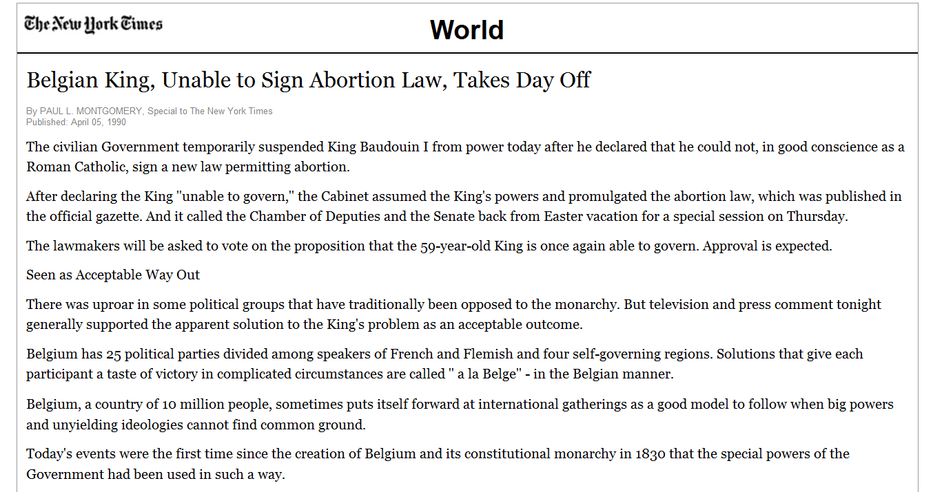
Historical example (DAS-1)
Change OS globally from BSDI Unix to Linux
Under directorship of Andy Tanenbaum

Slide 10

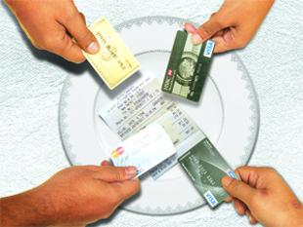


Financing
NWO ``middle-sized equipment’’ program
Max 1 M€, very tough competition, but scored 5-out-of-5
25% matching by participating sites
Going Dutch for ¼ th
Extra funding by VU and (DAS-5) COMMIT + NLeSC
SURFnet (GigaPort) provides wide-area networks
Commit/
Notes:
{going ¼ th Dutch}

Slide 11
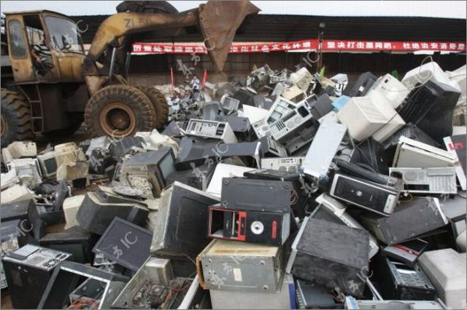

Steering Committee algorithm
FOR i IN 1 .. 5 DO
Develop vision for DAS[i]
NWO/M proposal by 1 September [4 months]
Receive outcome (accept) [6 months]
Detailed spec / EU tender [4-6 months]
Selection; order system; delivery [6 months]
Research_system := DAS[i];
Education_system := DAS[i-1] (if i>1)
Throw away DAS[i-2] (if i>2)
Wait (2 or 3 years)
DONE
Notes:
CS talk needs algorithms
INTEGER 2 or 3 years; overslept
Synchronous (BSP like) algorithm, unlike G5K

Slide 12
Output of the algorithm

Slide 13
Part II - Earlier results
VU: programming distributed systems
Clusters, wide area, grid, optical, cloud, accelerators
Delft: resource management [CCGrid’2012 keynote]
MultimediaN: multimedia knowledge discovery
Amsterdam: wide-area networking, clouds, energy
Leiden: data mining, astrophysics [CCGrid’2013 keynote]
Astron: accelerators
vrije Universiteit
Notes:
Algorithms for astrophysics

Slide 14
DAS-1 (1997-2002) A homogeneous wide-area system
200 MHz Pentium Pro
Myrinet interconnect
BSDI ➔ Redhat Linux
Built by Parsytec
VU (128 nodes)
Amsterdam (24 nodes)
6 Mb/s
ATM
Leiden (24 nodes)
Delft (24 nodes)

Slide 15


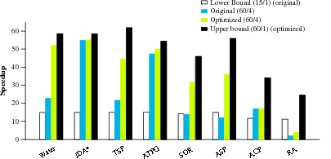
Albatross project
Optimize algorithms for wide-area systems
Exploit hierarchical structure ➔ locality optimizations
Compare:
1 small cluster (15 nodes)
1 big cluster (60 nodes)
wide-area system (4×15 nodes)

Slide 16
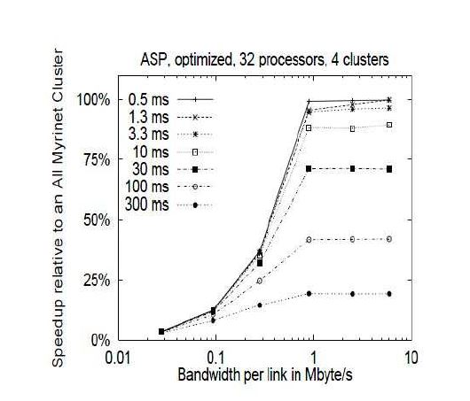
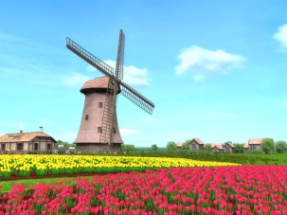
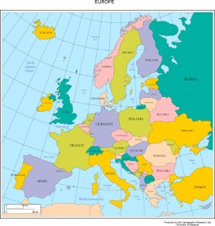

Sensitivity to wide-area latency and bandwidth
Used local ATM links + delay loops to simulate various latencies and bandwidths [HPCA’99]
Notes:
Applications didn’t care in the least; too early, Grid was not even introduced, they barely used clusters
JOKE:simulate <6 Mb, not everyone can have so much bandwidht

Slide 17

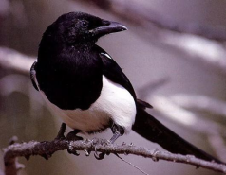

Wide-area programming systems
Manta:
High-performance Java [TOPLAS 2001]
MagPIe (Thilo Kielmann):
MPI’s collective operations optimized for hierarchical wide-area systems [PPoPP’99]
KOALA (TU Delft):
Multi-cluster scheduler with support for co-allocation
Notes:
Names MagPIe and KOALA (cf das-1, das-2 etc, boring)

Slide 18
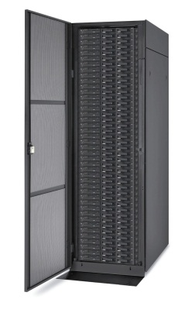
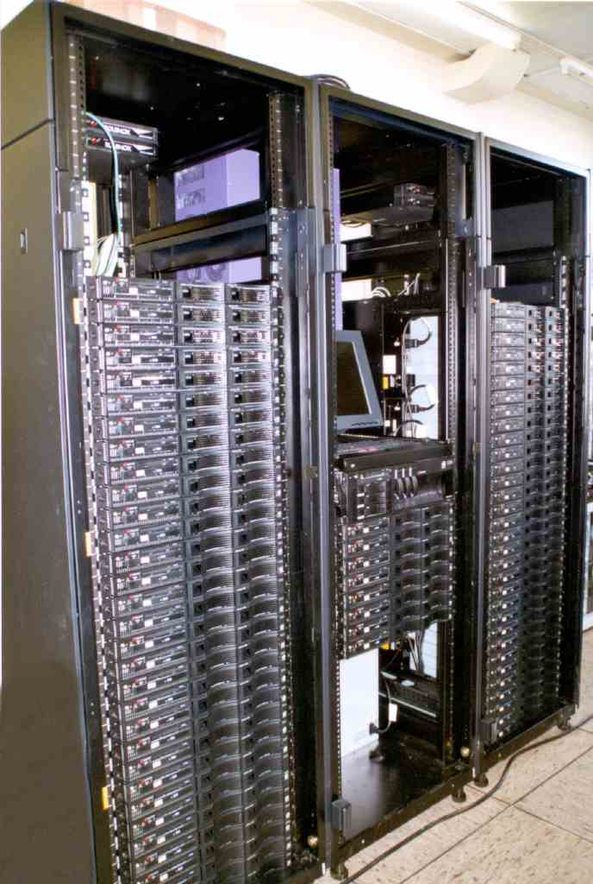
DAS-2 (2002-2006) a Computer Science Grid
two 1 GHz Pentium-3s
Myrinet interconnect
Redhat Enterprise Linux
Globus 3.2
PBS ➔ Sun Grid Engine
Built by IBM
VU (72)
Amsterdam (32)
SURFnet 1 Gb/s
Leiden (32)
Delft (32)
Utrecht (32)
Notes:
Someone invented the word GRID
DAS-1 is BEFORE grids

Slide 19

Grid programming systems
Satin (Rob van Nieuwpoort):
Transparent divide-and-conquer parallelism for grids
Hierarchical computational model fits grids [TOPLAS 2010]
Ibis: Java-centric grid computing [Euro-Par’2009 keynote]
JavaGAT:
Middleware-independent API for grid applications [SC’07]
Combined DAS with EU grids to test heterogeneity
Do clean performance measurements on DAS
Show the software ``also works’’ on real grids

Slide 20
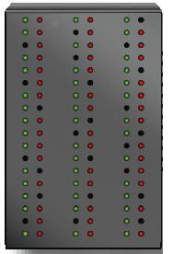
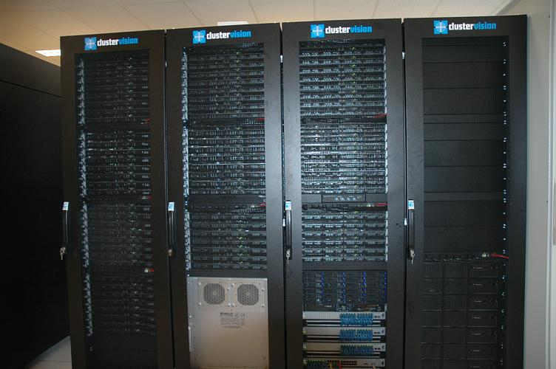
DAS-3 (2006-2010)
An optical grid
Dual AMD Opterons
2.2-2.6 GHz Single/dual core nodes
Myrinet-10G
Scientific Linux 4
Globus, SGE
Built by ClusterVision
UvA/MultimediaN (40/46)
VU (85)
SURFnet6
10 Gb/s
TU Delft (68)
Leiden (32)

Slide 21



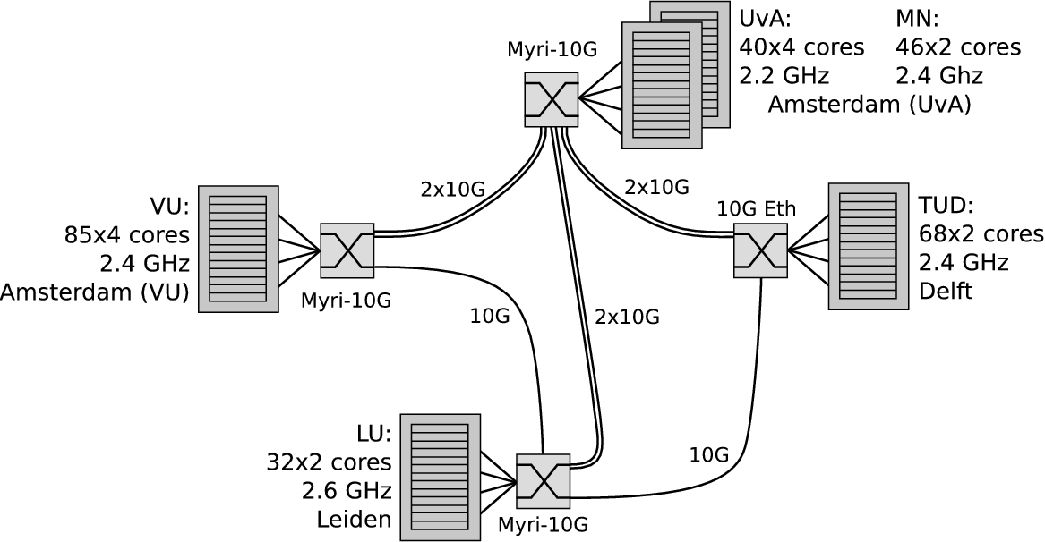
Multiple dedicated 10G light paths between sites
Idea: dynamically change wide-area topology

Slide 22
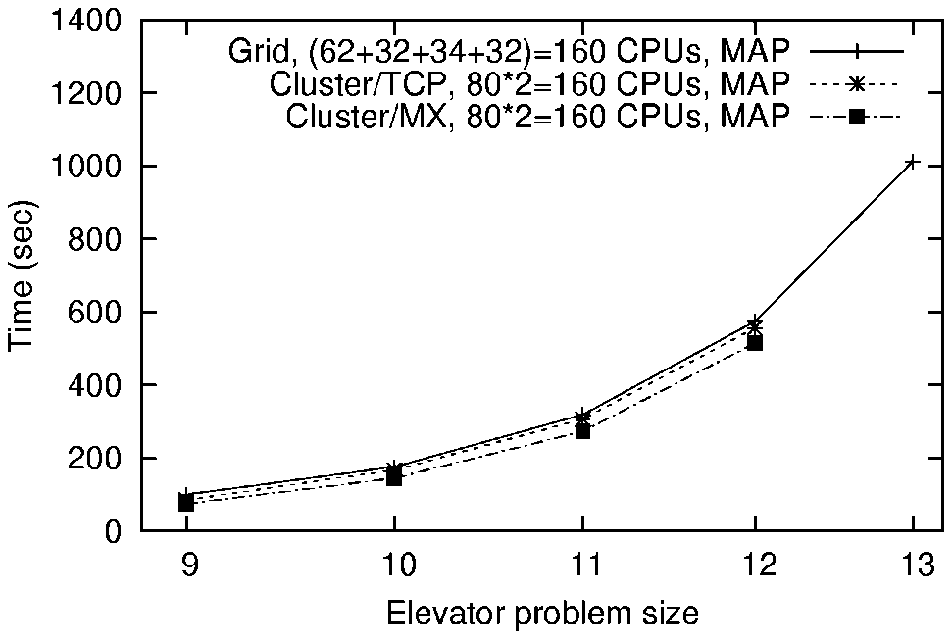
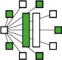




Distributed Model Checking
Huge state spaces, bulk asynchronous transfers
Can efficiently run DiVinE model checker on wide-area DAS-3, use up to 1 TB memory [IPDPS’09]
Notes:
Exponential algorithm. Why care about only 1 extra step (13)?
A lot of things go wrong at exactly this point.

Slide 23
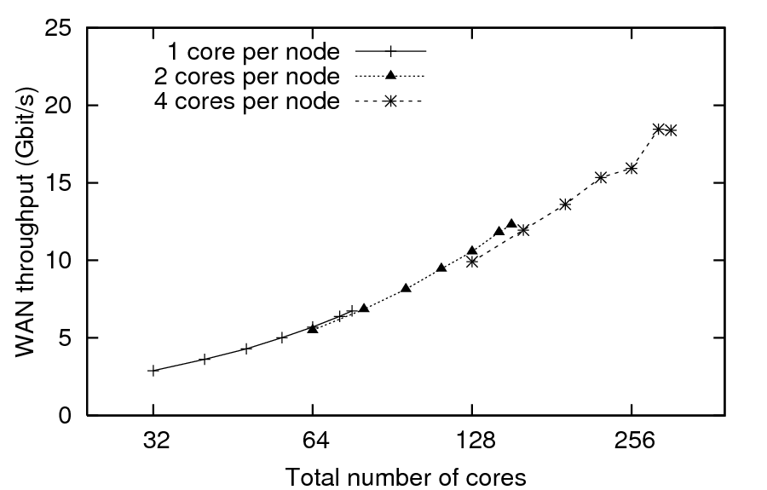
Required wide-area bandwidth

Slide 24
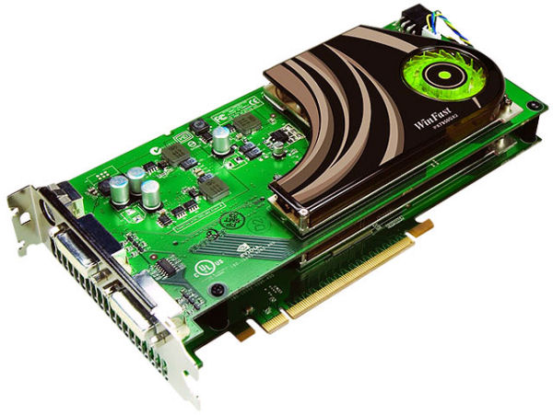
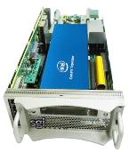
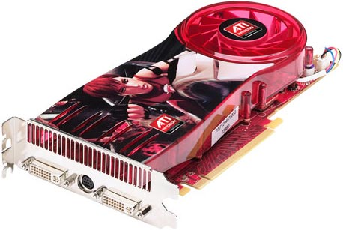
DAS-4 (2011) Testbed for Clouds, diversity, green IT
UvA/MultimediaN (16/36)
Dual quad-core Xeon E5620 Infiniband
Various accelerators
Scientific Linux
Bright Cluster Manager
Built by ClusterVision
VU (74)
SURFnet6
ASTRON (23)
10 Gb/s
TU Delft (32)
Leiden (16)

Slide 25
Recent DAS-4 papers
A Queueing Theory Approach to Pareto Optimal Bags-of-Tasks Scheduling on Clouds (Euro-Par ‘14)
Glasswing: MapReduce on Accelerators (HPDC’14 / SC’14)
Performance models for CPU-GPU data transfers (CCGrid’14) Auto-Tuning Dedispersion for Many-Core Accelerators (IPDPS’14)
How Well do Graph-Processing Platforms Perform? (IPDPS’14)
Balanced resource allocations across multiple dynamic MapReduce clusters (SIGMETRICS ‘14)
Squirrel: Virtual Machine Deployment (SC’13 + HPDC’14)
Exploring Portfolio Scheduling for Long-Term Execution of Scientific Workloads in IaaS Clouds (SC’13)

Slide 26
Highlights of DAS users
Awards
Grants
Top-publications

Slide 27
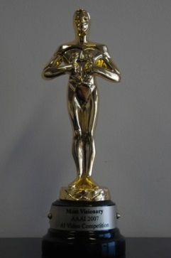
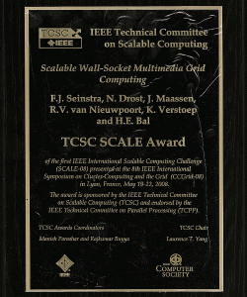
Awards
3 CCGrid SCALE awards
2008: Ibis
2010: WebPIE
2014: BitTorrent analysis
Video and image retrieval:
5 TRECVID awards, ImageCLEF, ImageNet, Pascal VOC classification, AAAI 2007 most visionary research award
Key to success:
Using multiple clusters for video analysis
Evaluate algorithmic alternatives and do parameter tuning
Add new hardware

Slide 28
More statistics
Externally funded PhD/postdoc projects using DAS:
100 completed PhD theses
Top papers:
DAS-3 proposal | 20
DAS-4 proposal | 30
DAS-5 proposal | 50
IEEE Computer | 4
Comm. ACM | 2
IEEE TPDS | 7
ACM TOPLAS | 3
ACM TOCS | 4
Nature | 2

Slide 29
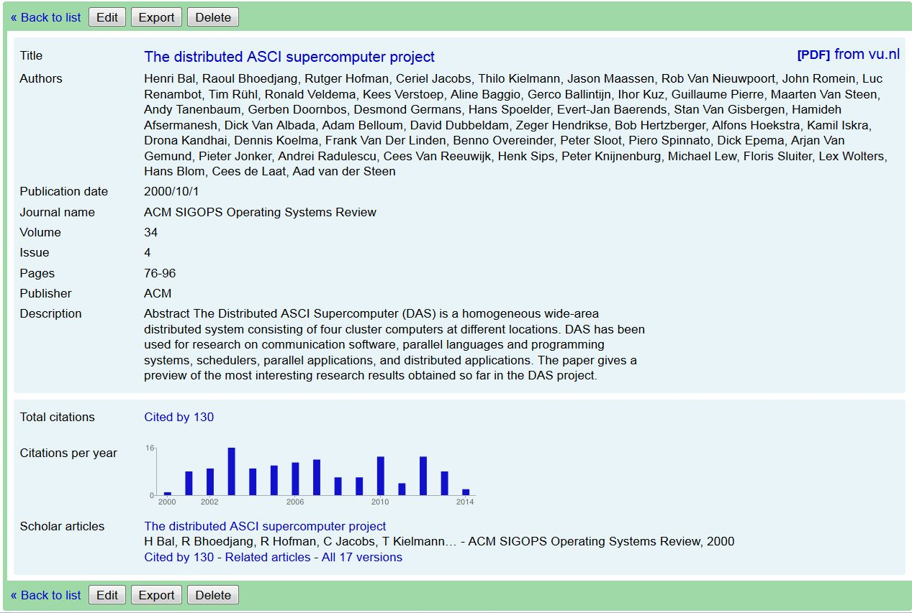
SIGOPS 2000 paper
50 authors
130 citations
Notes:
Coherent paper with 50 authors?

Slide 30
PART III: Current projects
Distributed computing + accelerators:
High-Resolution Global Climate Modeling
Big data:
Distributed reasoning
Cloud computing:
Squirrel: scalable Virtual Machine deployment

Slide 31

Global Climate Modeling
Netherlands eScience Center:
Builds bridges between applications & ICT (Ibis, JavaGAT)
Frank Seinstra, Jason Maassen, Maarten van Meersbergen
Utrecht University
Institute for Marine and Atmospheric research
Henk Dijkstra
VU:
COMMIT (100 M€): public-private Dutch ICT program
Ben van Werkhoven, Henri Bal
Commit/

Slide 32
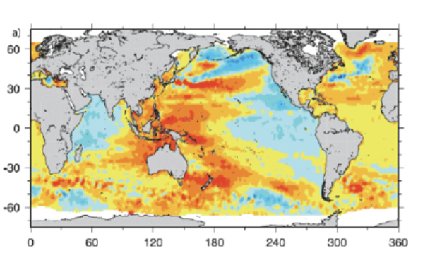
High-Resolution Global Climate Modeling
Understand future local sea level changes
Quantify the effect of changes in freshwater input & ocean circulation on regional sea level height in the Atlantic
To obtain high resolution, use:
Distributed computing (multiple resources)
Déjà vu
GPU Computing
Good example of application-inspired Computer Science research
Notes:
Applications typically want help with EXCEL spreadsheets !
Real computer scientists never ever use EXCEL

Slide 33

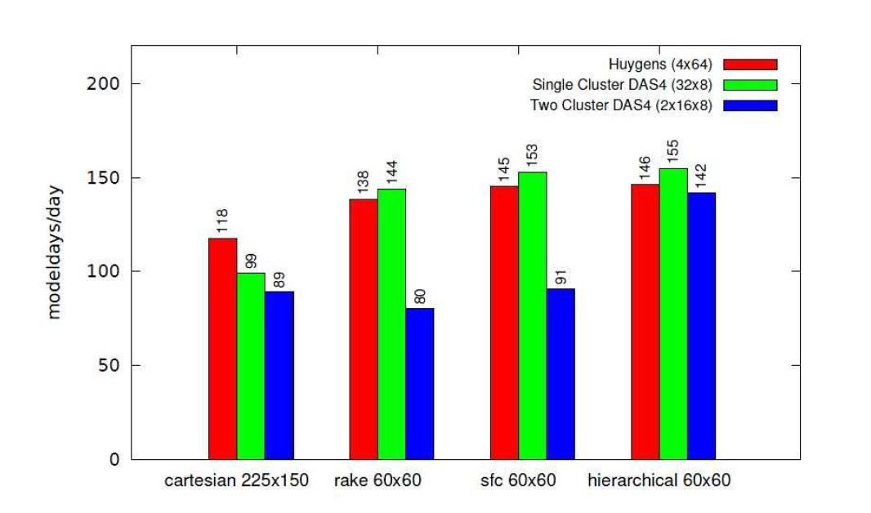
Distributed Computing
Use Ibis to couple different simulation models
Land, ice, ocean, atmosphere
Wide-area optimizations similar to Albatross (16 years ago), like hierarchical load balancing
Notes:
FORTRAN

Slide 34
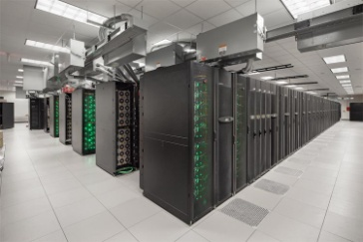
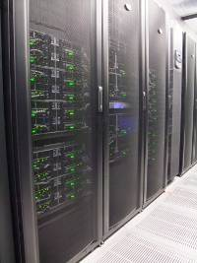
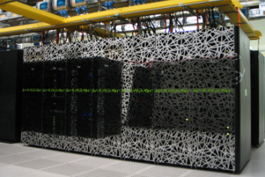
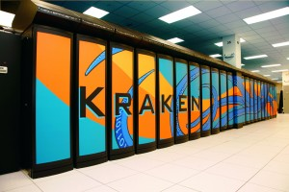
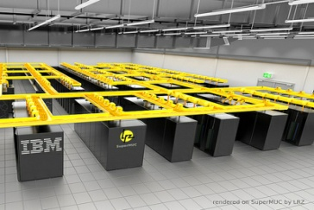










Enlighten Your Research Global award
10G
10G
#7
STAMPEDE (USA)
EMERALD (UK)
CARTESIUS (NLD)
10G
KRAKEN (USA)
SUPERMUC (GER)
#10
Notes:
Joke: use skype instead of telephone

Slide 35
GPU Computing
Offload expensive kernels for Parallel Ocean Program (POP) from CPU to GPU
Many different kernels, fairly easy to port to GPUs
Execution time becomes virtually 0
New bottleneck: moving data between CPU & GPU
CPU
host
memory
Host
PCI Express link
GPU
device
memory
Device

Slide 36
Different methods for CPU-GPU communication
Memory copies (explicit)
No overlap with GPU computation
Device-mapped host memory (implicit)
Allows fine-grained overlap between computation and communication in either direction
CUDA Streams or OpenCL command-queues
Allows overlap between computation and communication in different streams
Any combination of the above

Slide 37
Problem
Problem:
Which method will be most efficient for a given GPU kernel? Implementing all can be a large effort
Solution:
Create a performance model that identifies the best implementation:
What implementation strategy for overlapping computation and communication is best for my program?
Ben van Werkhoven, Jason Maassen, Frank Seinstra & Henri Bal: Performance models for CPU-GPU data transfers, CCGrid2014 (nominated for best-paper-award)

Slide 38
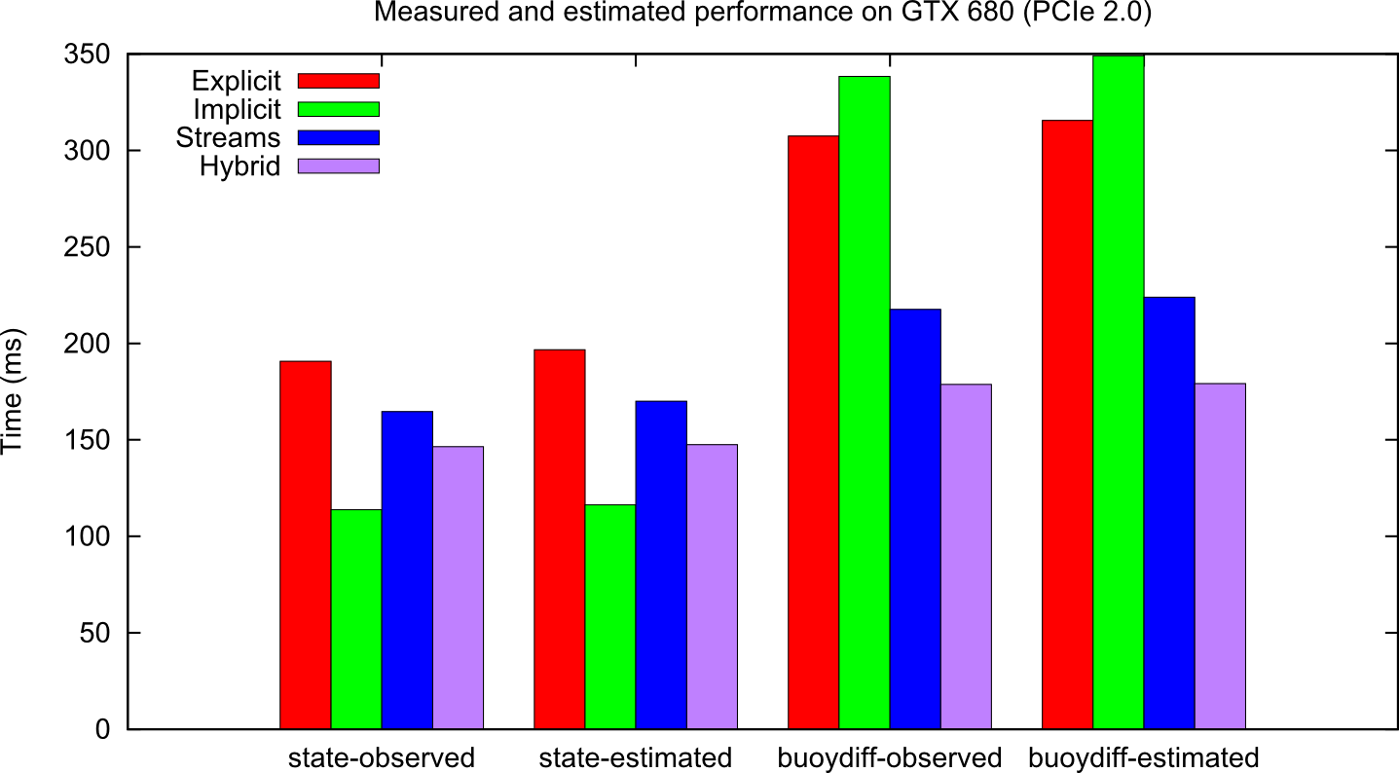
Example result
Implicit Synchronization and 1 copy engine
2 POP kernels (state and buoydiff)
GTX 680 connected over PCIe 2.0
Measured
Model
Notes:
CHECK: replace implicit synchr by mapped memory ??

Slide 39
MOVIE

Slide 40
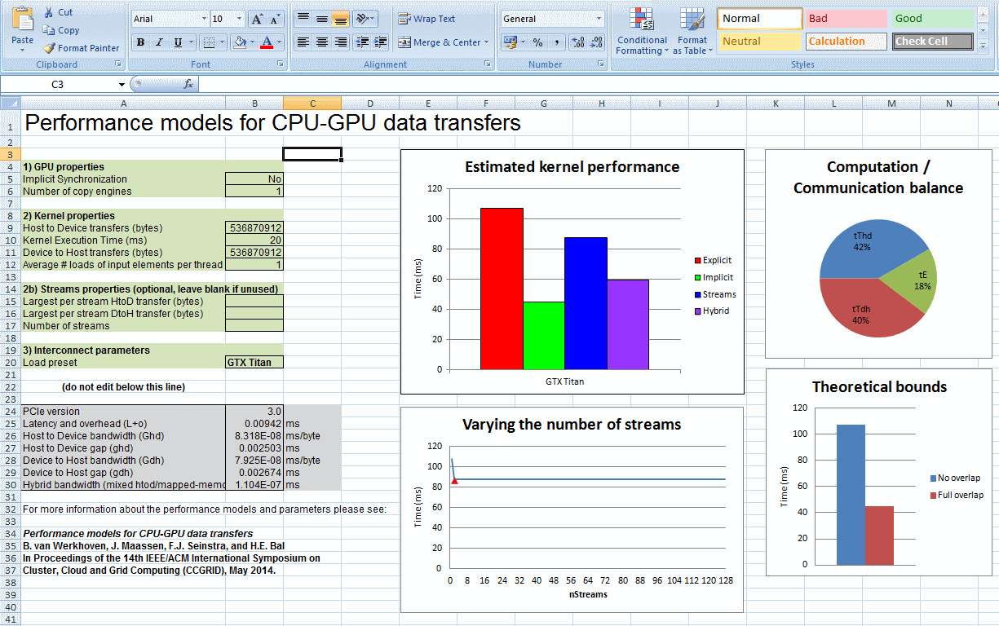
Comes with spreadsheet

Slide 41

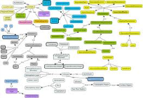

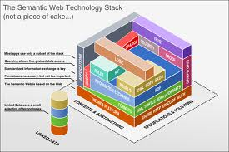
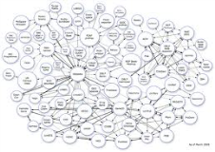

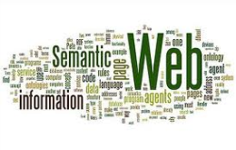
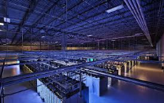

Distributed reasoning
Reason over semantic web data (RDF, OWL)
Make the Web smarter by injecting meaning so that machines can “understand” it
initial idea by Tim Berners-Lee in 2001
Now attracted the interest of big IT companies

Slide 42
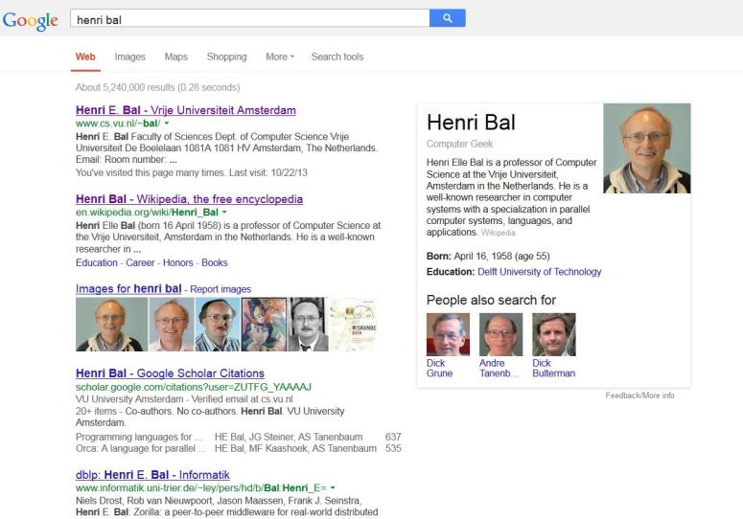

Google Example
Notes:
Awfull pictures, retract from Google?

Slide 43
WebPIE: a Web-scale Parallel Inference Engine (SCALE’2010)
Web-scale distributed reasoner doing full materialization
Jacopo Urbani + Knowledge Representation and Reasoning group (Frank van Harmelen)

Slide 44
Performance previous state-of-the-art

Slide 45
Performance WebPIE
Now we are here (DAS-4)!
Our performance at CCGrid 2010 (SCALE Award, DAS-3)

Slide 46
Reasoning on changing data
WebPIE must recompute everything if data changes
DynamiTE: maintains materialization after updates (additions & removals) [ISWC 2013]
Challenge: real-time incremental reasoning, combining new (streaming) data & historic data
Nanopublications (http://nanopub.org)
Handling 2 million news articles per day (Piek Vossen, VU)
Notes:
Gossiping algorithms?

Slide 47




Squirrel: scalable Virtual Machine deployment
Problem with cloud computing (IaaS):
High startup time due to transfer time for VM images from storage node to compute nodes
Scalable Virtual Machine Deployment Using VM Image Caches, Kaveh Razavi and Thilo Kielmann, SC’13
Squirrel: Scatter Hoarding VM Image Contents on IaaS Compute Nodes,
Kaveh Razavi, Ana Ion, and Thilo Kielmann, HPDC’2014
Commit/

Slide 48

State of the art: Copy-on-Write
Doesn’t scale beyond 10 VMs on 1 Gb/s Ethernet
Network becomes bottleneck
Doesn’t scale for different VMs (different users) even on 32 Gb/s InfiniBand
Storage node becomes bottleneck [SC’13]

Slide 49
Solution: caching
Only the boot working set
Cache either at:
Compute node disks
Storage node memory
VMI | Size of unique reads
CentOS 6.3 | 85.2 MB
Debian 6.0.7 | 24.9 MB
Windows Server 2012 | 195.8 MB

Slide 50

Cold Cache and Warm Cache
Notes:
When we get a read on the cache image, two scenar-
ios are possible. Either the data exists in the cache (warm
cache), or the data needs to be fetched from the base image
(cold cache). In the rst scenario, the data is read from the
cache image and returned to image requesting it (CoW im-
age). In the second scenario, we recurse to the base image
for the data. Once the data is available, before returning it
to the CoW image, we write it to the cache.
The cache is
created on the memory of the compute node to avoid slowing the VM
down due to expensive writes.

Slide 51
Experiments
DAS-4/VU cluster
Networks: 1Gb/s Ethernet, 32Gb/s InfiniBand
Needs to change systems software
Needs super-user access
Needs to do 100’s of small experiments

Slide 52

Cache on compute nodes (1 Gb/s Ethernet)
HPDC’2014 paper: Use compression to cache all the important blocks of all VMIs, making warm caches always available
Notes:
with a single
VMI, the difference between warm caches and QCOW2 is the cost of the network bottleneck.
Starting
from 16 VMIs, the storage node's disk is becoming the pri-
mary source of the scalability bottleneck. The VMI caching
at the compute nodes avoids both scalability bottlenecks at
the network and at the storage node's disk.

Slide 53
Discussion
Computer Science needs its own infrastructure for interactive experiments
Being organized helps
ASCI is a (distributed) community
Having a vision for each generation helps
Updated every 4-5 years, in line with research agendas
Other issues:
Expiration date?
Size?
Interacting with applications?

Slide 54

Expiration date
Need to stick with same hardware for 4-5 years
Cannot afford expensive high-end processors
Reviewers sometimes complain that the current system is out-of-date (after > 3 years)
Especially in early years (clock speeds increased fast)
DAS-4/DAS-5: accelerators added during the project

Slide 55

Does size matter?
Reviewers seldom reject our papers for small size
``This paper appears in-line with experiment sizes in related SC research work, if not up to scale with current large operational supercomputers.’’
We sometimes do larger-scale runs in clouds

Slide 56
Interacting with applications
Used DAS as stepping stone for applications
Small experiments
No productions runs (on idle cycles)
Applications really helped the CS research
DAS-3: multimedia → Ibis applications, awards
DAS-4: astronomy → many new GPU projects
DAS-5: eScience Center → EYR-G award, GPU work
Notes:
{not even ``idle cycles’’}

Slide 57

Expected Spring 2015
50 shades of projects, mainly on:
Harnessing diversity
Interacting with big data
e-Infrastructure management
Multimedia and games
Astronomy

Slide 58


Acknowledgements
Support:
TUD/GIS
Stratix
ASCI office
DAS grandfathers:
Andy Tanenbaum
Bob Hertzberger
Henk Sips
More information:
http://www.cs.vu.nl/das4/
DAS Steering Group:
Dick Epema
Cees de Laat
Cees Snoek
Frank Seinstra
John Romein
Harry Wijshoff
System management:
Kees Verstoep et al.
Hundreds of users
Funding:
Commit/

